Slide 1

Personal Expense Tracker -Aishwarya Dasaraju

Slide 2
Project Overview
Purpose: A web tool for effective money management.
Goal: To enable users to track, categorize and analyze their expenses.
Key Features: Budget setting and reporting, analytics of expenses.

Slide 3
Key Features
Expense Logging: Tracks daily expenses
Budget management: Set and manage budgets for each category
Analytics and Reporting: Visualizing spending patterns
Mobile and web access: Accessible on desktop and mobile platforms

Slide 4
Technologies used
Frontend: HTML, CSS, JavaScript, React.js for a dynamic user interface
Backend: Node.js, Express or Flask/Django, JWT Authentication for server-side logic
Data Visualization: Chart.js or D3.js for spending patterns
Hosting: AWS, Heroku

Slide 5
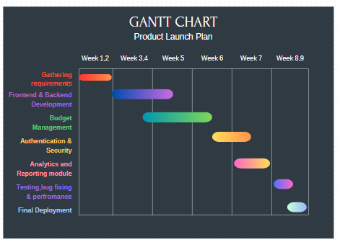

Slide 6


Slide 7
THANK YOU

